Slide 1
History of the Metis
Pemmican Proclamation
Battle of Seven Oakes
Red River Rebellion
Manitoba Act
Northwest Uprising
Hanging of Louis Riel

Slide 2
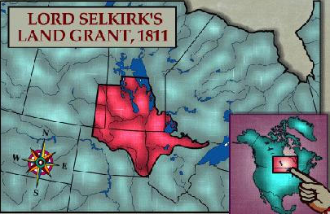
The History of the Metis
Lord Selkirk
-330,000km of traditional Metis land was given to Lord Selkirk by HBC
-his plan with the land: populate it with settlers and farm it
-1814 “Pemmican Proclamation”
→prevented Metis people from selling / trading food
→ Pemmican Proc + lost land = upset Metis
1816 The Battle of Seven Oaks:
-Metis fought against Selkirk and settlers
-the metis owned.
-this marked the birth of the Metis nation

Slide 3
Red River Rebellion:
1869 – HBC sold Ruperts Land (traditional Metis land) to Canada
-Metis not consulted
-Metis not recognized as ‘land owners’
-gov’t wanted to populate area with settlers and farm it
-divided the land into square townships
-disregarded the established Metis strip farms
The Metis Reaction – a rebellion
-Louis Riel – leader of the Metis Rebellion
-The Rebellion – Metis owned again
– imprisoned all against them
– executed Thomas Scott
-Riel created “Metis Bill of Rights”
(a constitution that defined and protected Metis people of Canada)

Slide 4
Red River Rebellion: the birth of a Métis province
Canada’s Reaction:
-negotiated with Metis
-recognized Metis Bill of Rights
-signed Manitoba Act
1870 Manitoba Act:
-agreement btw. Metis and Canada
-resulted in new province – Manitoba
-seen as a Metis province
-Metis were promised:
-protection of Metis culture and way of life
-1.4 million hectares of land (Manitoba)

Slide 5
After the Manitoba Act
-Canada changed its mind!
-sent 1200 soldiers to Manitoba
-Riel fled to the US for fear of being imprisoned
-gov’t very slow in giving land to Metis
-decided to issue “land scrip”
–certificates that awarded Metis 160-240 acres (usually poor quality)
-Canada sent more and more settlers Manitoba
The Result:
-Metis continue to get discriminated
-many move west

Slide 6
The Northwest Uprising 1885: fight for Metis rights
Lead up to the Uprising:
-agreements of Manitoba Act not honored
-Metis not receiving promised land
-buffalo hunted to near extinction
-increased # of settlers moving into Metis traditional area
-CPR (railway) was displacing Metis people
Gabriel Dumont and Louis Riel’s response:
-1884 organized and led an attack against the gov’t
-3 key battles in 1885 from March to May
Duck Lake and Fish Creek were Metis victories
Batoche → resulted in the surrender of the Metis resistance

Slide 7
After the loss at Batoche (Metis Surrender)
-The Govt had many Trials to convict the Metis supporters
-Big Bear and Poundmaker (FN chiefs that fought along Riel)
-charged with high treason
-sentenced to 3 years in prison
-both died within a few months of returning to their reserve (poor health)
-Gabriel Dumont – fled to the US
-Louis Riel – charged with “High Treason”
-tried by a jury of 6 English speaking protestants (he was french catholic)
-tried under a 500 year old British law rather than the Canadian Treason law –done so that he could be executed rather than imprisoned
-Nov 16 1885 he was hanged

Slide 8
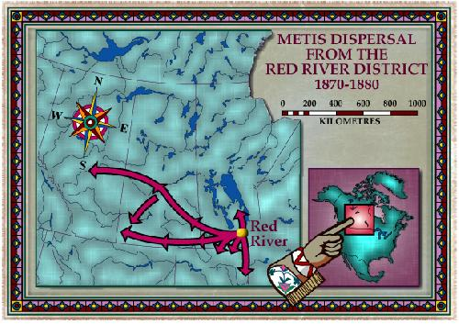
Many Metis moved west…
-after Riel’s death, many Metis migrated west to Sask, Albt, and BC

