Slide 1
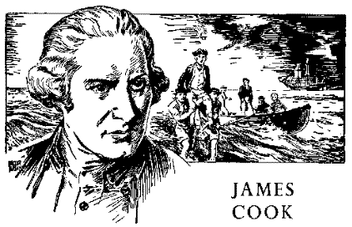
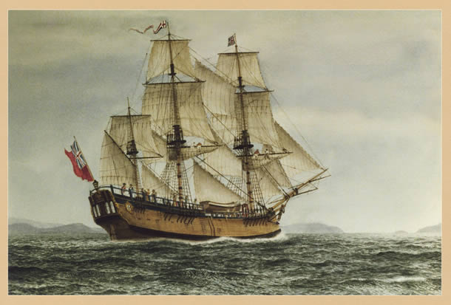
Important Sailors

Slide 2
Important Sailors:
Christopher Columbus: 1492 reached the Americas → this sparked the international rivalry for European countries to claim all the worlds land –all you had to do was get their first and essentially call “Shotty”
2. Juan de Fuca: although no proof, Juan de Fuca is said to have reached the Southern tip of Vancouver island in 1592
3. Sir Francis Drake: 1759 reached the Oregon Coast
4. JUAN PEREZ: 1774 reached present day Queen Charlotte Islands – first known European to make contact with BC FN’s (the Haida Gwaii)
5. CAPTAIN COOK: 1778 reached Vancouver Island – first to touch BC soil
*
*

Slide 3
First “known” Contact in British Columbia:
1774 Juan Perez
-1774 reached the Queen Charlotte Islands (Haida Nation)
-His crew stayed on their ship
→ Haida people canoed to ship and traded some furs
-Also went to the Nuu-Chah-Nulth (Vancouver Island)
→ traded for coppers
→ this expedition led to other Europeans navigating their way to the west coast of BC to get a better understanding of what actually was available to “take” in the part of the world

Slide 4
Captain Cook:
-1st European to touch BC coast soil (March 29, 1778)
-he was instructed by his King (King George III) to claim any lands that looked uninhabited
-he spent 1 month with the Nuu-chah-nulth
-he called the people “Nootka” because he thought that was their name – really it meant “go around” – they were instructing the sailors to go around the point to find a safer area to anchor
-returned to England with 1500 sea otter pelts
-this sparked the maritime fur trade
-within 25 years approx. 200 European ships made their way to BC to trade furs (esp. sea otter pelts)

