Slide 1
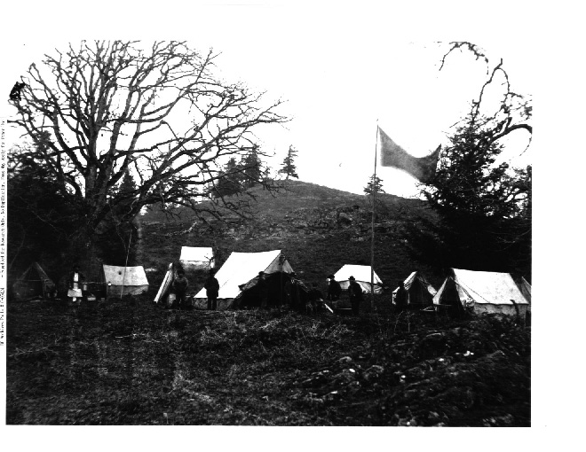
McKenna-McBride & The Cut Off Lands

Slide 2
McKenna-McBride Commission (1912-1916)
What was it?
-a large report on “Indian Affairs” that focused on RESERVES
-the report was designed to solve the “Indian Problem”
The Task of the Commission:
-to meet with every reserve
-consult about reserve lands and address FN grievances
-some reserve refused to participate

Slide 3
The Results:
-approx. 47,000 acres of reserve land were removed
-approx. 87,000 acres of land added to reserves
-this land came to be known as “CUT OFF LANDS”
Cut Off Lands:
-land of value taken from existing reserves
-land given to reserves of poor value (if any returned at all)
Example: Many costal nations had reserves in downtown urban lower mainland / Vancouver area. Much of these lands were taken and in return they were given reserve land in less desirable areas (ex. Mountain sides)
Further outcomes of McKenna-McBride
-Increased restrictions were placed on FNs mobility
-resistance to govt. authority was made illegal (no more protests)

