Slide 1
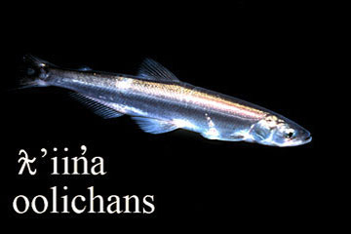
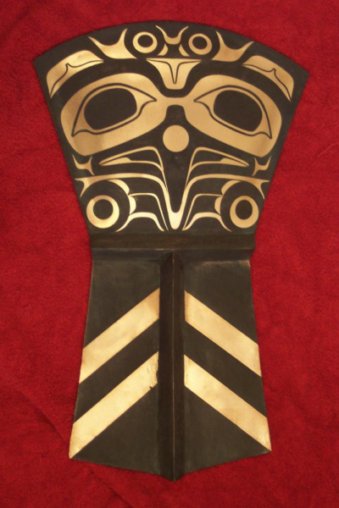
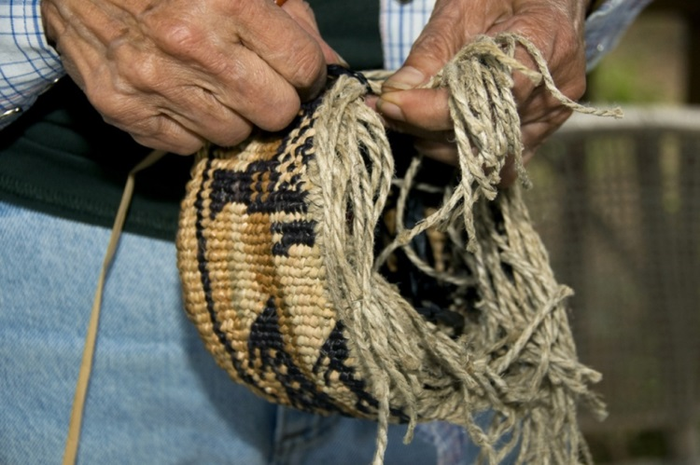
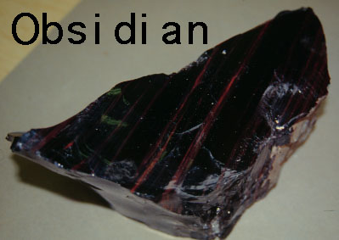
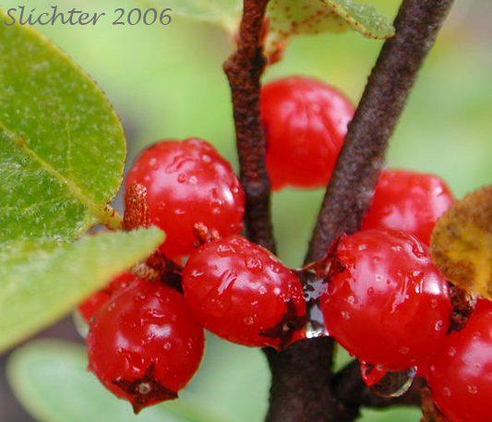
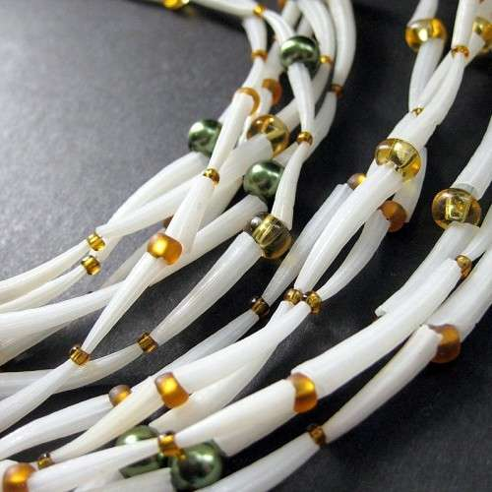
Important Trade Items

Slide 2
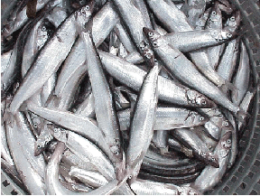
Important Trade Items:
1) Oolichan: the ever important and nutritious fish oil
→ the small fish that yielded Oolichan oil were found in the ocean. FN’s would extract the oil and then take to the interior of BC to trade with the interior peoples
Grease Trails: refers to the trails that created and maintained for the trading of Oolichan oil (large numbers of FN’s would travel these trails to trade for oolichan)
-Only found on the Coast of B.C. (pacific ocean)
Play to 1:45

Slide 4
Important Trade Items Cont’d.
2) Obsidian: a glass like volcanic rock which was used to make cutting tools – it was highly valuable because of its tiny razor sharp microblades were essential to creating sharp edges (knives)
→ today Obsidian is used in surgeon scalpels.
- only 2 places in BC where obsidian can be found:
1) in Tahltan Territory
2) in Dakelh
-Again, FN groups traveled across BC territories to trade for Obsidian
-scientists can prove that Obsidian was traded up to 8,000 years ago (they can prove this through a method called carbon dating)

Slide 5
Obsidian Arrow Head Clip

Slide 6
Important Trade Items Cont’d:
3) Soapberry (Soopolallie): found only in the Interior regions of BC → it was a delicacy that was used to make “Indian Ice Cream”
-the berries and other parts of the plant were used for medicinal purposes
-Soapberries would be traded to the costal peoples for foods from the sea – such as dried cockles and herring

Slide 7
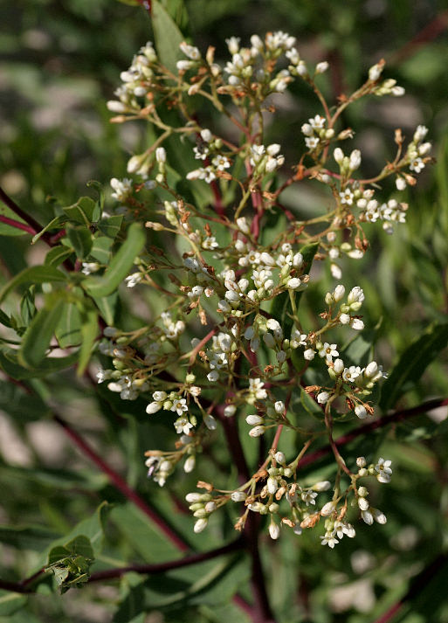
Important Trade Items Cont’d.
4) Indian Hemp: It is an extremely important fibre that was used in many FN creations → string, twine, rope, baskets, nets, traps etc.
-it is found only in the dry climates of the S. Interior (Okanagan and East Kootenay)
-the S. Interior nations traded hemp with neighbouring Nlaka’pamux for salmon and animal skins
-they also made long treks to the coast to trade for coastal items

Slide 8
Trade items Cont’d:
5) Dentalium: a small tusk-like shell that is found on the coast – but only in sub-tidal waters (on the west coast of Vancouver Island)
-Nuu-chah-nulth and Kwakwaka’wakw nations took the shells and created prestigious trade items such as necklaces, earrings etc.
-Dentalium was a symbol of wealth – VERY RARE

Slide 9
Trade Items Cont’d:
6) Copper Shields:
-Coppers were only found on the North-West Coast (VERY RARE)
(Kwak Waka’wakw, Tlingit)
-copper was used to decorate carvings such as masks
-also used in the creations of “Coppers” → these were large shields
- Copper Shields were the ultimate symbol of wealth for the North-West Nations
-given away at potlatches
-designed with hereditary crests

Slide 10
Trade Items cont’d.
7) Slaves: people that were captured during warfare and taken into a FN community –they would be forced to help that nation (usually in the form of labour)
-generally more common on the costal territories
-a sign of wealth and prestige
-chiefs would have slaves and use them for labour
-Slaves became an important trade commodity

Slide 11
All the trade items just covered are broken into 2 main groups:
1) Items of Necessity: (needed for survival)
-Oolichan, Obsidian, Soapberry, Indian Hemp
-all of the standard resources that were traded → salmon, halibut, furs, plants etc.
2) Items of Prestige / Wealth:
-Dentalium, Copper, Slaves
-owning these items was a symbol of wealth
All of these items had a Medium of Exchange
-something that people agree has a value and can be used to exchange goods and services
-this means that they acted as money does today

