Slide 1
The Numbered Treaties

Slide 2
Numbered Treaties
-Unlike BC, the other Canadian provinces signed and negotiated treaties
The Numbered Treaties (1870s) [Treaties 1-7]
-7 huge treaties signed in the Prairie Provinces
-each family received 160 acres or more
-these treaties recognized that ABORIGINAL TITLE EXISTS
-FN leaders in BC hoped that similar treaties would be signed with them
➔ instead, BC continued to deny the existence of Aboriginal Title and FN’s were forced to live on tiny reserves --- mere remnants of their traditional territories

Slide 3
Numbered Treaties → Treaty 8 (1899)
-Signed in the Dene-Thah and Dunne-Za Nations of BC (also parts of Alb / Sask / NWT)
Why was it signed when BC denied Aboriginal Title?
-threat of war → FN of the Northeast were growing tired of disrespectful miners in their territories
-Canada did not want a war
-BC (despite this) REFUSED to sign a treaty
-Canada demands that BC sign a treaty - BC still refuses
-Canada signs a treaty → Treaty 8 on behalf of BC
BC 1st Nations also want to sign TREATIES

Slide 4
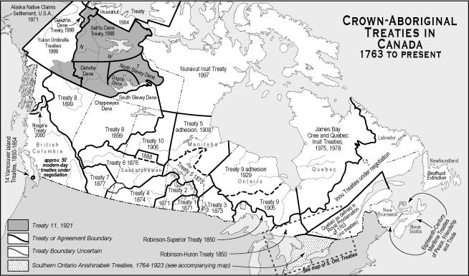
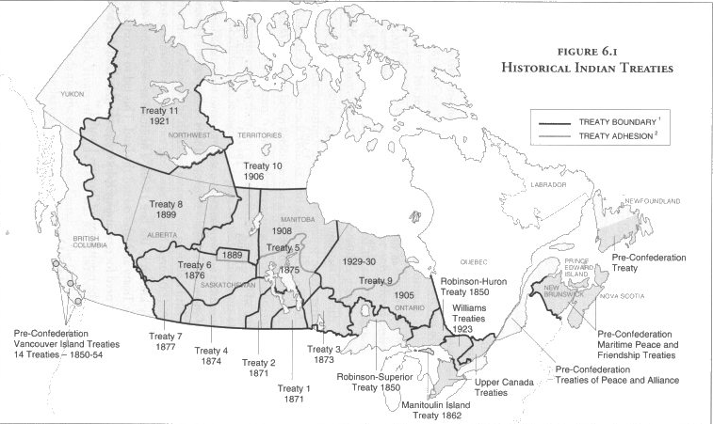
Numbered Treaties
Look at BC

